Slide 1
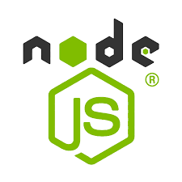
Node js – Module And OS – Module
Presented by :
A.D Shamitha
22H51A05D1
CSE D

Slide 2
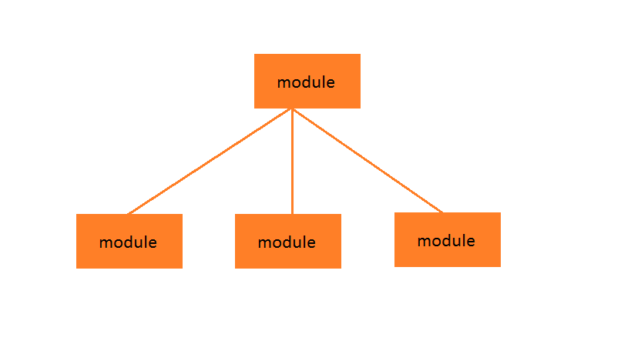
Node js
Node.js is an open source server environment
Node.js is free
Node.js runs on various platforms (Windows,
Linux, Unix, Mac OS X, etc.)
Node.js uses JavaScript on the server.
Node.js uses asynchronous programming!

Slide 3
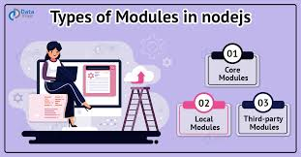
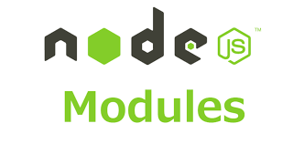
Node.js Modules
Node.js, Modules are the blocks of encapsulated code that communicate with an external application on the basis of their related functionality.
Modules can be a single file or a collection of multiple files/folders.
The reason programmers are heavily reliant on modules is because of their reusability as well as the ability to break down a complex piece of code into manageable chunks.

Slide 4
Types of node.js modules :
1.) Core Modules
Node.js has many built-in modules that are part of the platform and come with Node.js installation. These modules can be loaded into the program by using the required function.
Syntax : const module = require('module_name’);
The require() function will return a JavaScript type depending on what the particular module returns. The following example demonstrates how to use the Node.js http module to create a web server.
Code :
const http = require('http');
http.createServer(function (req, res) {
res.writeHead(200, { 'Content-Type': 'text/html' });
res.write('Welcome to this page!');
res.end();
}).listen(3000);

Slide 5
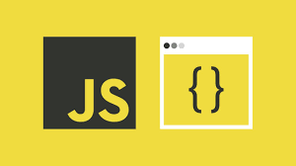
2.) Local Modules :
Unlike built-in and external modules, local modules are created locally in your Node.js application. Let’s create a simple calculating module that calculates various operations.
Create a calc.js file that has the following code :
exports.add = function (x, y) {
return x + y;
};exports.sub = function (x, y) {
return x - y;
};exports.mult = function (x, y) {
return x * y;
}; exports.div = function (x, y) {
return x / y;
};

Slide 6
Since this file provides attributes to the outer world via exports, another file can use its exported functionality using the require() function.
// Filename: index.js
const calculator = require('./calc');
let x = 50, y = 10;
console.log("Addition of 50 and 10 is " + calculator.add(x, y));
console.log("Subtraction of 50 and 10 is “ + calculator.sub(x, y));
console.log("Multiplication of 50 and 10 is “ + calculator.mult(x, y));
console.log("Division of 50 and 10 is "+ calculator.div(x, y));
Output :
Addition of 50 and 10 is 60 Subtraction of 50 and 10 is 40 Multiplication of 50 and 10 is 500 Division of 50 and 10 is 5

Slide 7
3.) Third-party modules
Third-party modules are modules that are available online using the Node Package
Manager(NPM). These modules can be installed in the project folder or globally. Some of
the popular third-party modules are Mongoose, express, angular, and React.
Example:
npm install express , npm install mongoose , npm install -g @angular/cli
Create a Simple Express Server:
Code :
const express = require('express’);
const app = express();
const port = 3000;
app.get('/', (req, res) => {
res.send('Hello World!');});
app.listen(port, () =>{
console.log(`Example app listening at http://localhost:${port}`);
});

Slide 8
Built-in modules
Node.js has a set of built-in modules which you can use without any further installation.Here is a list of the built-in modules of Node.js version 6.10.3:
Module | Description
assert | Provides a set of assertion tests
buffer | To handle binary data
child_process | To run a child process
cluster | To split a single Node process into multiple processes
crypto | To handle OpenSSL cryptographic functions
dgram | Provides implementation of UDP datagram sockets
dns | To do DNS lookups and name resolution functions
domain | Deprecated. To handle unhandled errors
events | To handle events

Slide 9
fs | To handle the file system
http | To make Node.js act as an HTTP server
https | To make Node.js act as an HTTPS server.
net | To create servers and clients
os | Provides information about the operation system
path | To handle file paths
punycode | Deprecated. A character encoding scheme
querystring | To handle URL query strings
readline | To handle readable streams one line at the time
string_decoder | To decode buffer objects into strings
timers | To execute a function after a given number of milliseconds
url | To parse URL strings
v8 | To access information about V8 (the JavaScript engine)
vm | To compile JavaScript code in a virtual machine
zlib | To compress or decompress files

Slide 10
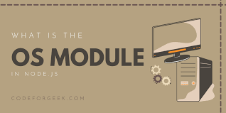
OS - Module
The OS module is a built-in module in NodeJS that provides
operating system-related functionality.
It allows you to access information about the underlying
operating system on which the NodeJS application is running.
The OS module is useful for tasks that require information
about operating system.
This can include tasks such as determining the platform on
which the application is running, retrieving information about
system resources, or working with network interfaces.
It provides functions to interact with the operating system.
It provides the hostname of the operating system and
returns the amount of free system memory in bytes

Slide 11
How to Use the OS Module:
The OS module provides various functions and properties to access information about the operating system. Some of the commonly used functions and properties include:
os.arch(): Returns the CPU architecture of the operating system (e.g., ‘x64’, ‘arm’).
os.cpus(): Provides an array of objects describing each CPU/core installed.
os.freemem(): Returns the amount of free system memory in bytes.
os.homedir(): Returns the path to the current user’s home directory.
os.hostname(): Returns the hostname of the operating system.
os.networkInterfaces(): Returns a list of network interfaces and their details.
os.platform(): Returns the operating system platform (e.g., ‘linux’, ‘darwin’).

Slide 12
os.release(): Returns the operating system release.
os.totalmem(): Returns the total amount of system memory in bytes.
os.uptime(): Returns the system uptime in seconds.
Features :
System Information: Provides insights into the system’s hardware and software environment.
Resource Monitoring: Helps in monitoring memory usage and system performance.
Platform Detection: Identifies the platform and version of the operating system.

Slide 13
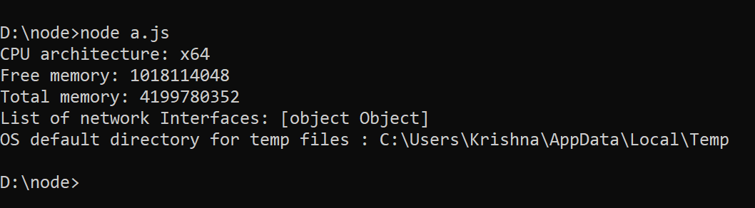
Example 1: This example uses Node.js os module to fetch and display system details and memory info.
a.js : const os = require('os’);
console.log("CPU architecture: " + os.arch());
console.log("Free memory: " + os.freemem());
console.log("Total memory: " + os.totalmem());
console.log('List of network Interfaces: ' + os.networkInterfaces());
console.log('OS default directory for temp files : ' + os.tmpdir());
Output :

Slide 14


